Slide 1
CS312
Artificial Intelligence
Course Introduction
Lecture # 00
HITEC University, Taxila
Mr. Mubashir Iqbal
Fall-2025

Slide 2
Introduction
Course Code | CS-312
Course Title | Artificial Intelligence
Credit Hours | 2 (2+0)
Contact Hours | 2 (2+0)
Semester | BS CyS 3rd Semester — Fall 2025
Prerequisite | CS1xx - Object Oriented Programming

Slide 3
Books
Recommended Books:
Russell, Stuart J., and Peter Norvig. Artificial intelligence: a modern approach. Pearson Education Limited, 3rd Edition. ISBN-13: 978-0136042594
Reference Books:
Michalski, Ryszard S., Jaime G. Carbonell, and Tom M. Mitchell, eds. Machine learning: An artificial intelligence approach. Springer Science & Business Media, 2013. ISBN 978-3-662-12405-5
Richard O. Duda, Peter E. Hart and David G. Stork, “Pattern Classification, Wiley Inter-science, 2nd edition, 2006.

Slide 4
Grading Policy
75% class attendance is mandatory to appear in the examination. Course grades will be determined by the following weights:
Theory (100%)
Assignments | 4x | 10.0%
Quizzes | 6x | 10.0%
Mid Exam | 1x | 30.0%
Final Exam | 1x | 50.0%
Course Total (100%) |  | 100%

Slide 5
List of Topics

Slide 6
Topics covers till Mid-Term
An Introduction to Artificial Intelligence and its applications towards Knowledge Based Systems;
Uninformed Search Algorithms:
  Breadth First Search (BFS)
  Depth First Search (DFS)
  Depth Limited Search
  Uniform Cost Search
  Bidirectional Search
  Iterative Deepening Depth First Search.

Slide 7
Topics covers till Mid-Term
Informed Search Algorithms - I:
  Heuristic Function and its role
  Best First Search (BFS)
  Beam Search - Optimized Best First Search
  A Star(A*) Search Algorithm
  AO Star (AO-) Search Algorithm
Informed Search Algorithms - II:
  Hill Climbing Search
  Branch and Bound Technique
  State Space Search - Eight Tile Puzzle Problem

Slide 8
Topics covers till Mid-Term
Knowledge representation:
  Introduction to Knowledge Representation (KR)
  Propositional Logic in AI (Syntax, Equivalence and Rules of Inference)
  First-Order Logic (FOL) - Predicate Logic & Quantifiers
  Unification Algorithm in Artificial Intelligence with example.
  Forward and Backward Chaining
  Constraint Satisfaction Problems (CSP)
Expert Systems & Inference Mechanisms:
  Architecture of Expert Systems
  Significance of Inference Engine in Expert Systems
  Knowledge Acquisition in AI
  Rule-Based Systems vs. Case-Based Systems

Slide 9
Topics covers till Mid-Term
Knowledge Representation Expansion:
  • Types of Knowledge in AI (Procedural, Declarative, Meta, Heuristic, Structural)
  • Semantic Networks (Components and Examples)
  • Frames for knowledge Representation (Attributes, Reasoning Actions)
  • Scripts in knowledge Representation – (Structure and Representation)
  • Bayes Theorem and Bayesian Belief Networks in AI
Adversarial Search & Game Theory in AI:
  • Introduction to Adversarial Search
  • Minimax Algorithm and Its Applications
  • Alpha-Beta Pruning for Optimization

Slide 10
Topics Covers, Mid ~ Final-Term
Introduction to Datasets and Online Platforms:
  Introduction to dataset,
  Searching and Downloading datasets from different online platforms
  Preprocessing, Exploratory Data Analysis (EDA) and Data Visualization
Introduction to Machine Learning (ML):
  Types of ML: Supervised, Unsupervised, Reinforcement Learning
  Regression (Linear and Logistic)
  Classification Techniques
  Model Evaluation Metrics (Accuracy, Precision, Recall, F1-Score)
  Hyperparameter Tuning and Overfitting

Slide 11
Topics Covers, Mid ~ Final-Term
Advanced Machine Learning Algorithms – I:
  Decision Trees, Random Forests, Support Vector Machines (SVM)
Advanced Machine Learning Algorithms – II:
  Unsupervised Learning
  K-Means Clustering
Introduction to Deep Learning – I:
  Introduction to Artificial Neural Networks (ANN)
  Multi-Layer Perceptron (MLP) and Backpropagation
Introduction to Deep Learning – II:
  Activation Functions
  Convolutional Neural Networks (CNNs)

Slide 12
How to get Good Grades

Slide 13
How to get Good Grades
Set Clear Goals
  Decide what GPA or grade you want and remind yourself regularly.
Attend Classes Regularly
  Don’t miss lectures; being present makes learning easier.
Take Smart Notes
  Write key points in your own words, not just what’s on the slides.
Review Weekly
  Spend 30–60 mins each week revising; don’t wait until exams.
Ask Questions
  Never hesitate to clarify doubts in class or with the teacher.

Slide 14
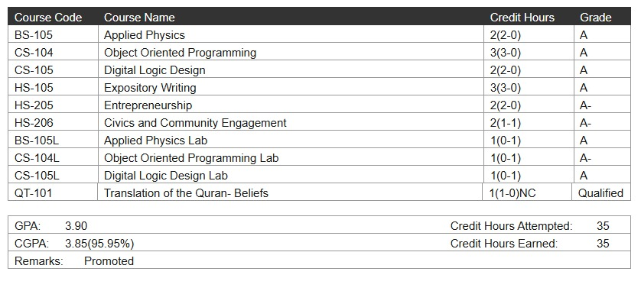
Student Example

Slide 15
How to get Good Grades
Stay Organized
  Keep track of assignments, quizzes, and exam dates.
Practice Daily
  Solve problems, write code, or attempt MCQs to strengthen memory.
Form Study Groups
  Discussing with classmates helps you understand better.
Use Office Hours
  Meet your teachers for extra guidance on tough topics.
Manage Time Wisely
  Use a planner or to-do list; avoid last-minute cramming.

Slide 16
How to get Good Grades
Limit Distractions
  Reduce social media, gaming, and Netflix during study hours.
Stay Healthy
  Sleep well, eat balanced meals, and exercise; a fresh mind learns faster.
Practice Past Papers
  Train your brain with previous exam questions.
Balance Studies & Fun
  Take breaks and reward yourself for completing tasks.
Believe in Yourself
  Confidence + consistent effort = excellent results.

Slide 17


